Slide 1
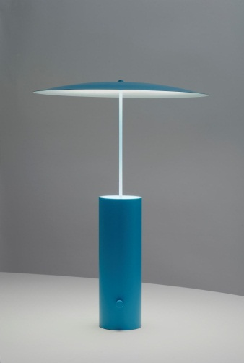
N4/5 Design & manufacture
Course aims, content and expectations

Slide 2
National 4/5 Design & manufacture
This course is made up of Two Units that split into specific
Learning Outcomes:
Unit A - Design and Manufacture: Design
Outcome 1: Identify factors that influence design
Outcome 2: Develop and communicate design concepts
Outcome 3: Evaluate an existing product
Unit B - Design and Manufacture: Materials and Manufacturing
Outcome 1: Investigate materials for manufacturing
Outcome 2: Prepare for manufacturing
Outcome 3: Plan and implement a manufacturing sequence for a prototype
Outcome 4: Review the manufacturing processes and finished prototype
All students will satisfy the Learning Outcomes by completing a number of Design Task. These tasks will involve research, design, planning and manufacture of models and prototypes. Students working at National 4 level will also have an Added Value Unit to complete. Students working at National 5 level will have a Design Assignment (90 marks) and an external exam (60marks)

Slide 3
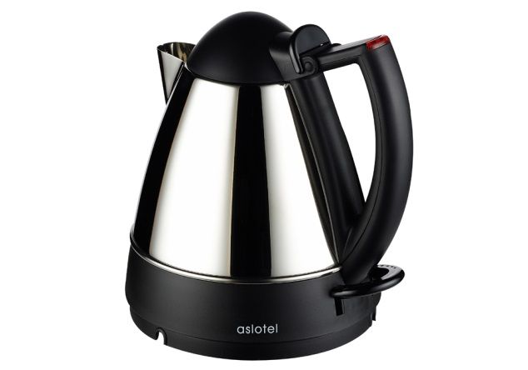
Task 1: Product Evaluation
Outcome 3: Evaluate an existing product
Students will take an everyday product that they are familiar with and produce a full Product Evaluation, this will include:
Identifying Design Factors
Justification of identified factors
Evaluation strategies
Product Testing/comparison/performance
Evaluation of results
This will be produced on a Publisher Documents and will be a minimum of eight pages of work.
= Excellent
= Very Good
= Good
= Below Average
= Poor
All students should complete this unit before the summer holiday break. Failure to do so will require students to complete unfinished work at home or at lunchtimes.

Slide 4
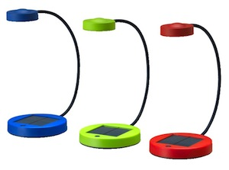
Task 2:
Lamp design
Outcome 1 :Investigate materials for manufacturing tasks
1.1 Selecting potential materials to suit manufacturing tasks based on information given in working drawings and design proposals
1.2 Testing the suitability of selected materials in terms of workability, practicability, function and performance
1.3 Recommending final selection of materials for manufacture of component parts of prototypes.
1.4 Explaining why final selection of materials for the prototype is appropriate in terms of aesthetics, workability, practicability, function and performance
1.5 Using correct names and terminology when referring to materials and their properties
Outcome 2:Develop and communicate design concepts
2.1Using graphic and modelling techniques to develop and communicate design ideas in 2D and 3D
2.2Justifying final design proposal in terms of evolution of design ideas and relevant design factors
2.3Presenting a design concept, including an updated product specification, in a form to permit manufacture
2.4Planning for manufacture
Model Making
Produce a scaled prototype
Evaluate prototype against specification
Identify the potential materials and manufacturing processes used in the industrial manufacture of the final concept
All students will produce a Design Folio for the Teenage Lamp Task. This will take students through all aspects of the Design Process and enhance their research skill, drawing skills and knowledge and understanding of appropriate technology.

Slide 5
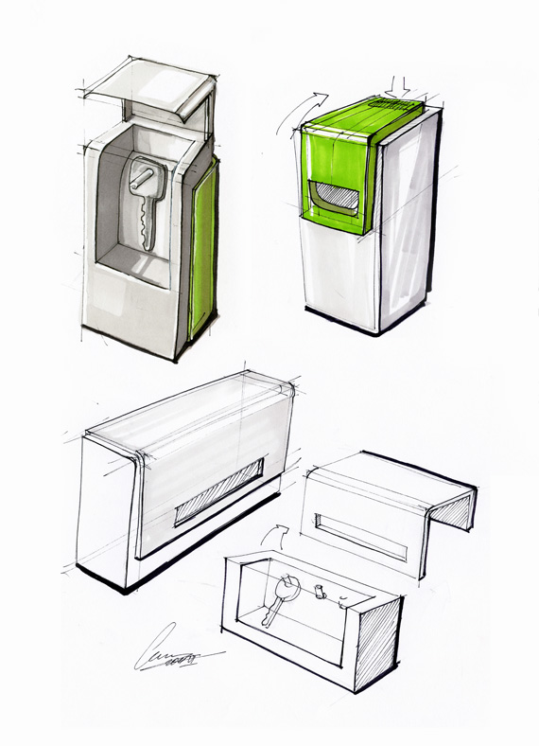
Task 3:
Storage Cabinet
Outcome 3 and 4
Plan and Manufacture a prototype identify appropriate construction methods , tools and manufacturing processes
4.1Evaluating the success of the manufacturing plan and outlining suggestions for improvement in terms of practicalities and efficiency
4.2Evaluating the prototype and outlining suggestions for improvement in terms of craftsmanship and finish
4.3Recommending changes in design that would improve the commercial manufacture of the prototype as a product in terms of economy, efficiency and sustainability
4.4Researching and recommending materials and manufacturing processes that might be used in a commercial setting to mass-produce products based on the prototype
Outcome 2
Develop and communicate design concepts.
Planning for Manufacture
Outcome 1
Analysing, researching, summarising and specifying a design proposal
All students will produce a detailed design folio covering all aspects of the design process through to the manufacture and evaluation of the concept.

Slide 6
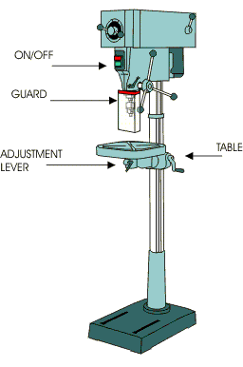
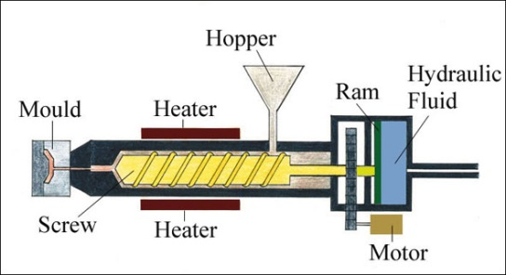
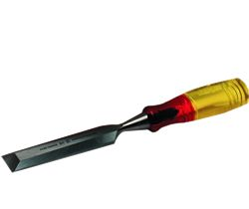
Technology, Evaluation & Safe working practices
Students will have a knowledge and Understanding of manufacturing Processes that enable various materials to be joined, shaped and formed within a workshop and an industrial situation.
Students will have a knowledge and Understanding of machinery and tools used to enable various materials to be joined, shaped and formed.
Students have a knowledge and Understanding of Safe Working Practices within a Workshop Environment . This will ensure safety for all at all times. Unsafe behaviour or conduct will not be tolerated.
Students will be introduced to testing materials and why they are used in the manufacture of everyday products.
All students will cover all related technology to National 5 Design & Manufacture. This will be enhanced by having a series of Homework Exercises and regular topic assessment to ensure all pupils have the potential to achieve national 5 level.

Slide 7
Weekly Period structure
To ensure that all topic areas are completed and students are ‘On Track’ with the course and their work the 4 Period week will be divided into:
Technology Knowledge and Understanding (1 period minimum)
Product Evaluation (1 period minimum –ICT resources required)
Design Tasks (2 periods)
Students will be kept to a strict timeline for completion of work. Unfinished work must be completed at home or during lunchtime within the Technical Department.
All students will need to show a more mature attitude to all aspects of their work throughout the year. This will ensure all work is completed to a standard that reflects their true ability and should result in successfully attaining a National 5 pass.

Slide 8
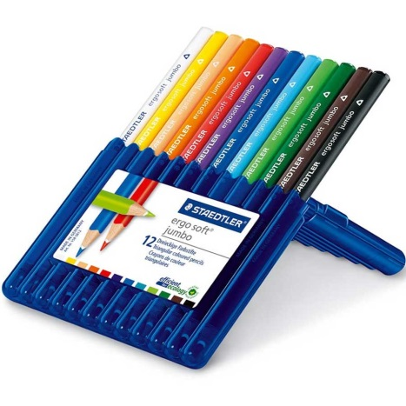
Equipment and homework
Equipment
Students will be issued with a Homework Technology Booklet.
Students will be expected to buy their own set of HB and Coloured pencils to enable them to complete sketching or design exercise at home.
Homework (A minimum of TWO homework exercises per week)
Students will be expected to complete design sketching at home.
Students will be given one homework exercise relating to the design assignment they are working on. This could range from design research, tool & machine technology, manufacturing processes, product evaluation, etc..
HOMEWORK IS COMPULSORY AND SHOULD BE COMPLETED BY ALL STUDENTS

