Slide 1
THE A to Z of DTP
Your knowledge of desktop publishing terminology
will be expanded as you progress within the subject

Slide 2
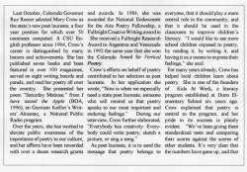
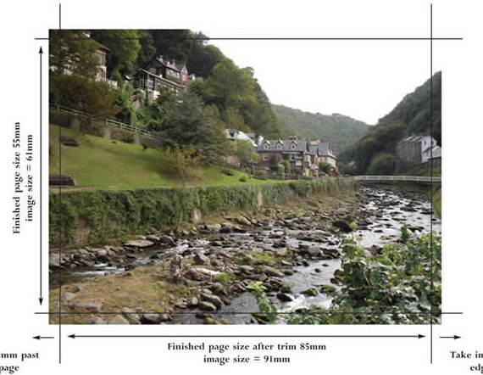
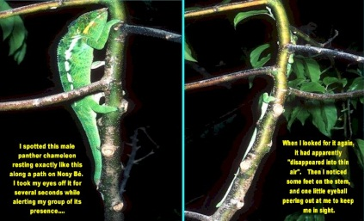
THE A to Z of DTP
ALIGNMENT – positions of text lines on a page or column e.g. aligned right, aligned left or fully justified.
Fully justified
BLEED – this is to extend an artwork graphic beyond the trimmed edge of the page. The bleed is the extent to which it exceeds the page, commonly 3mm.
Bleed
CAPTION – this is the descriptive text which accompanies a graphic or illustration.
Caption
COLUMN – The body of the text is restricted to the width of the lines. It makes the text easier to read and gives visual impact.
Column

Slide 3
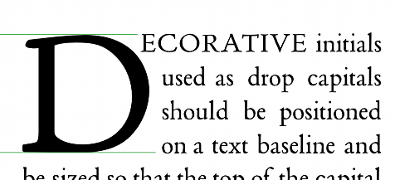
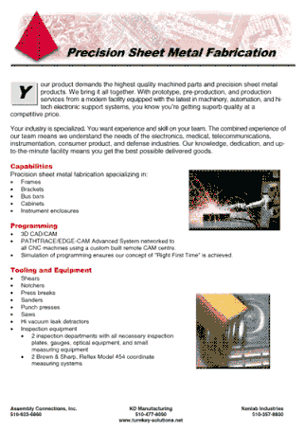
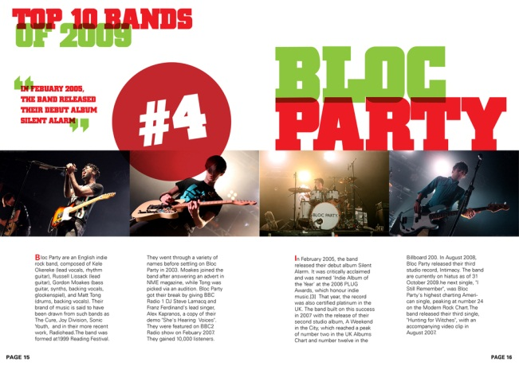
THE A to Z of DTP
DROP CAPITALS – A larger first letter signals the start of the article
Drop Capital
FOOTER – a line of text or page number placed at the bottom of the page which is repeated throughout the document.
Footer
GRAPHIC – an illustration prepared on a paint, draw, CAD package or captured by image scanner which is then imported into a DTP layout.
Graphic

Slide 4
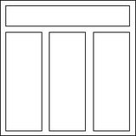
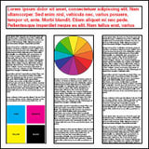
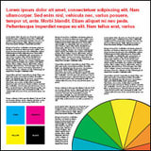
Design
Grid
A grid is an invisible structure used to guide the placement of elements on your page. Grids don't appear on the printed piece but their influence may be evident in the widths of text columns, the uniformity of space around photographs, or the consistent placement of repeating elements from page to page in a magazine. They are a series of guidelines that determine the margins of the piece, space between page elements (headlines, body text, photographs, etc.), and let you know where to put things on the blank page.
Basic Grid
Add Text and Graphics
Switch off Grid to see final result

Slide 5
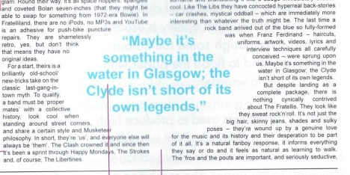
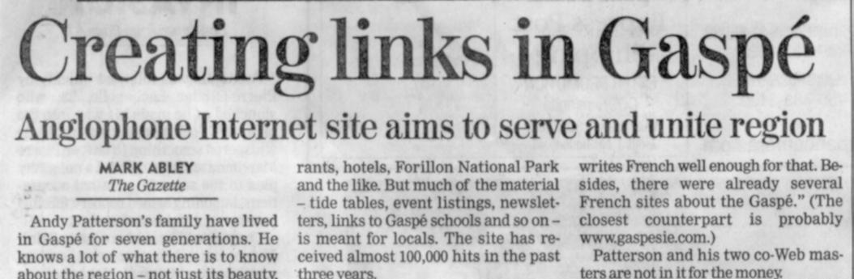
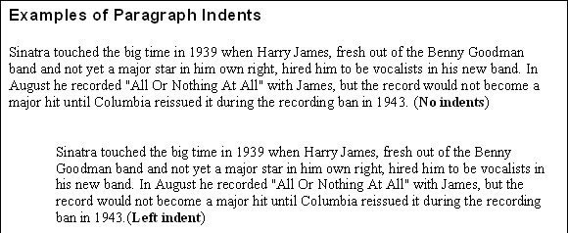
THE A to Z of DTP
GUTTER– A narrow space that separates columns. It contributes white space to a layout and helps to Decluter a page.
Gutter
HEADLINE – line of type set in a display (large) placed above accompanying text. Usually guides the reader on the content of the body text.
Headline
INDENT – beginning a line of text further in from the left margin then the rest of the text.
Indent

Slide 6
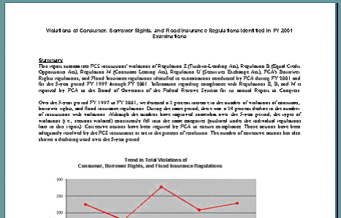
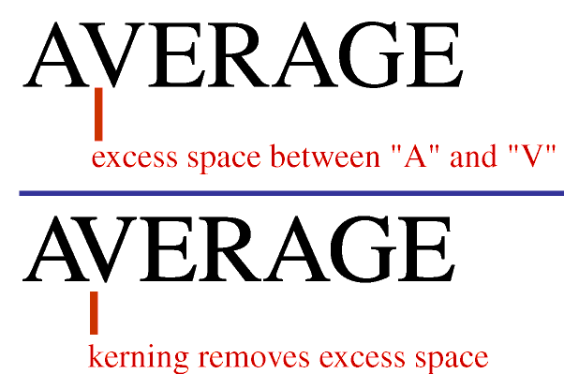
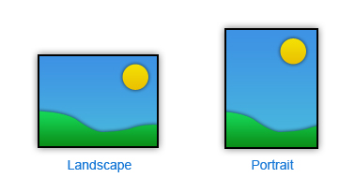
THE A to Z of DTP
JUSTIFICATION – setting of type lines in which the space between words is varied from line to line so that each line is of equal length.
Justification
KERNING– a DTP function which is used to adjust the spacing between pairs of individual letters on a page. Used to eliminate unwanted white space.
Kerning
LANDSCAPE – a page layout function which arranges the page so that its widest side is horizontal
Landscape

Slide 7
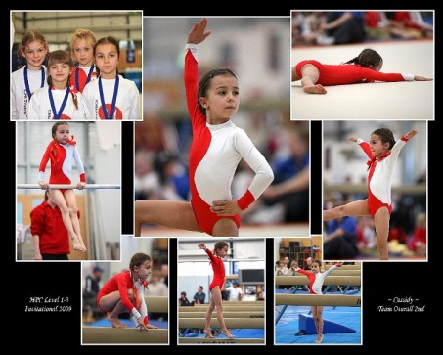
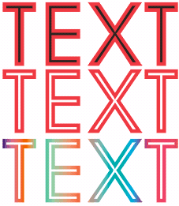
THE A to Z of DTP
MONTAGE – a combination of separate images combined to give a composite picture/image.
OUTLINE – a typeface which uses an outline effect.
Outline
PORTRAIT – a page layout function which arranges the page so that its widest side is vertical.
Portrait

Slide 8
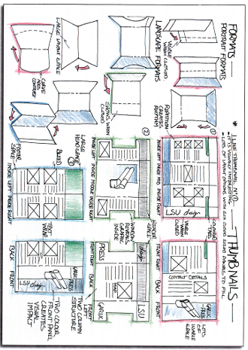
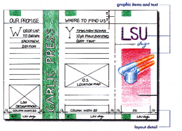
THE A to Z of DTP
Preliminary Graphics
Thumbnails Sketches –
Purpose – These quick pen or pencil sketches allow the designer to try out several ideas and zero in on the most likely layouts before beginning a project.
Creating thumbnails is a crucial part of the brainstorming aspect of your design work.
Working Rough -
Purpose - let you refine and develop your ideas . The sketches should be larger and include more detail than thumbnails.
We will be missing this step out in your national 4/ 5 course work.
Visuals -
Purpose – The manually drawn items are full size to scale and give the client a good idea of what the end product would look like.
Gives the client an opportunity to visualise the end product and make any changes to the page.

Slide 9
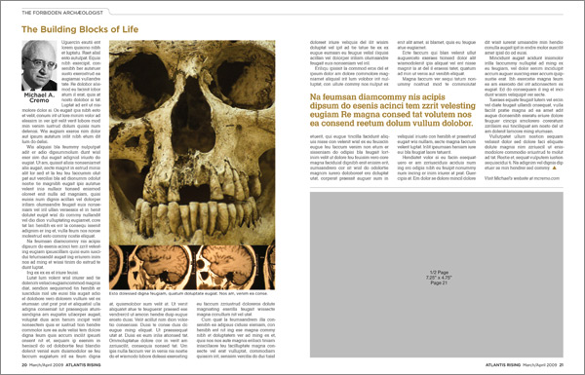
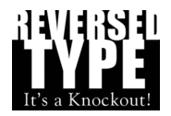
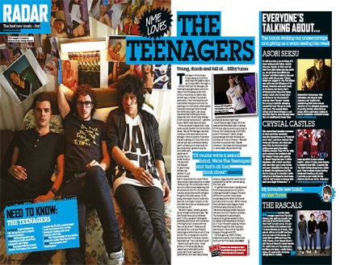
THE A to Z of DTP
Pull Quote
This is selected text enlarged and emboldened or coloured it draws the readers into the article and is often a lively quote.
Reversal
A lighter typeface on a darker background, such as white text on a black background, is reversed type.
Sub Heading
Sub Heading breaks text into meaningful sections, aid readability by breaking up large blocks of text, make it easier for readers to skim an article for relevant information, and also add visual interest to a page.

Slide 10
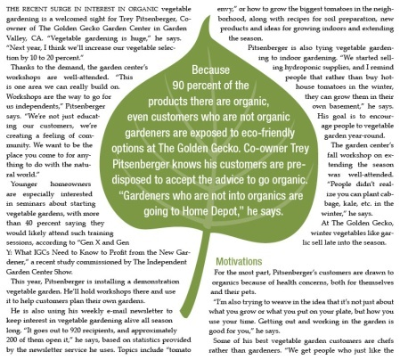
THE A to Z of DTP
Text Wrap
The text wraps of flows around a cropped image. It brings an informal modern feel to the page.
Underline
An underline, also called an underscore, is one or more horizontal lines immediately below a portion of writing. Single, and occasionally double ("double-underscore"), underlining was originally used in hand-written or typewritten, documents to emphasise text.

Slide 11
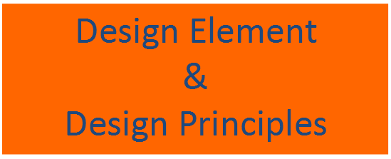
To achieve visual impact the designer must refer to a list of important guidelines called
Design Elements and Design Principles

Slide 12
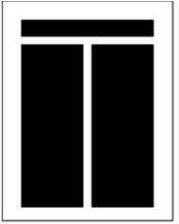
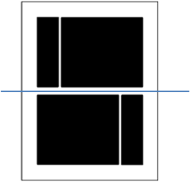
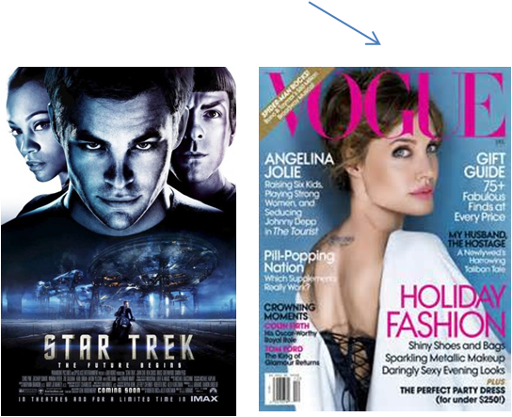
Design Principles
Balance
Symmetrical balance - is easiest to see in perfectly centered compositions or those with mirror images. In a design with only two elements they would be almost identical or have nearly the same visual mass. When a design can be centred or evenly divided both vertically and horizontally it has the most complete symmetry possible.
Lines of Symmetry
Why use it ?
Symmetrical balance generally lends itself to more formal, orderly layouts. They often convey a sense of tranquillity or familiarity or elegance or serious contemplation.

Slide 13

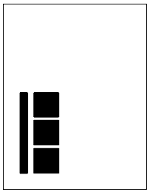
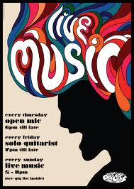

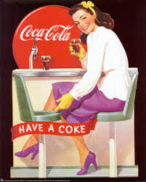
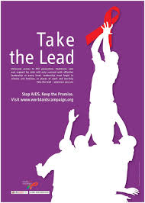
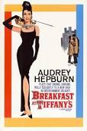
Design Principles
Balance – cont.
Asymmetrical Balance is typically off-center or created with an odd or mismatched number of disparate elements. However, you can still have an interesting design without perfect symmetry.
Some examples of poster using Asymmetrical Balance
Why use it ?
Asymmetrical layouts are generally more dynamic and by intentionally ignoring balance the designer can create tension, express movement, or convey a mood such as anger, excitement, joy, or casual amusement.

Slide 14
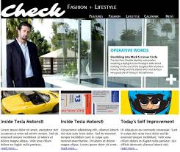
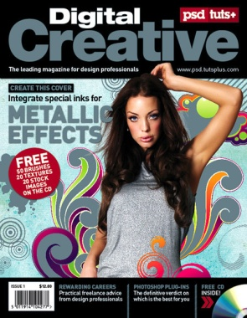

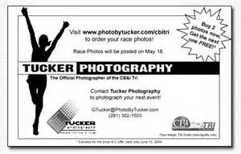
Design Elements
Shape
Carefully examine posters magazines and flyers to identify shapes.
Shapes are often used but can be used in many different ways.
Shapes can be:
  Geometric shapes – triangles, squares, circles.
  Natural shapes – leaves, flower petals.
  Abstract shapes – a blend of geometric and natural shapes.
Used to:
  Highlight Information
  Organize or Separate Information
  Make the Design More Interesting
What Certain Shapes Mean
Squares and Rectangles
Symbolize honesty, stability, equality and comfort.
Circles
Symbolize infinity, security and completeness.
Can you understand why these shapes have been chosen ?
Triangles
Symbolize action or conflict.

Slide 15
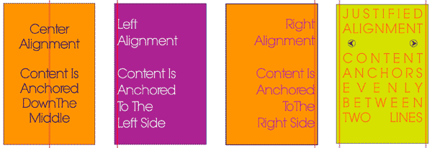
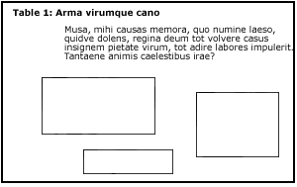
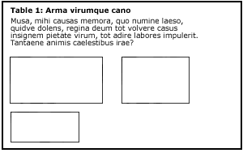
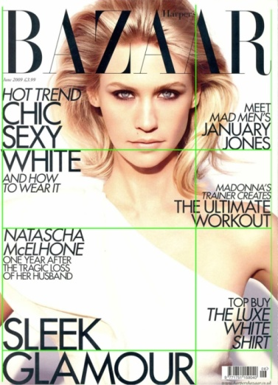
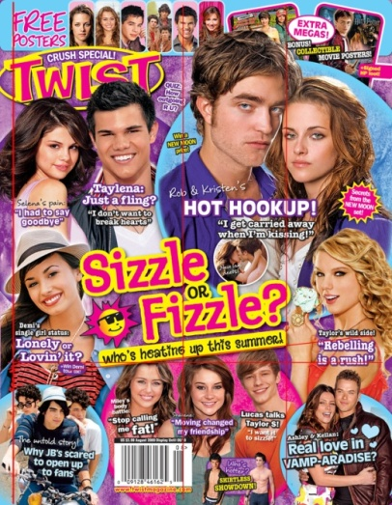


Design Principles
Alignment .
Alignment: In Order to Create Visual Unity
The principle of alignment states that the designer should use alignment of elements such as text and images as a tool to create visual unity or organization. Designers recommend that each element placed should have at least some alignment with another element on the page.
Basic forms of alignment look for the imaginary line.
Lack of Unity; Poor Alignment
Visual Unity Through Alignment
Good example of Alignment between text and image. (Look for the imaginary lines)
Poor example of Alignment between text and image.
Why use it ?
Good alignment is invisible. Most readers won't consciously notice that everything is lined up neatly but they will feel it when things are out of alignment.

Slide 16
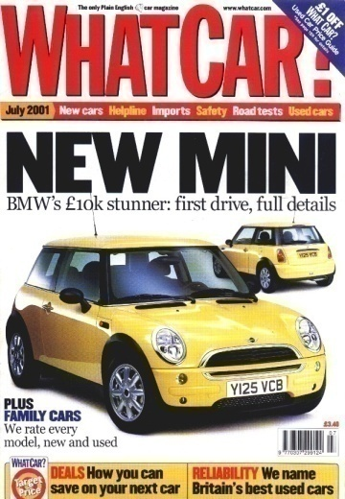
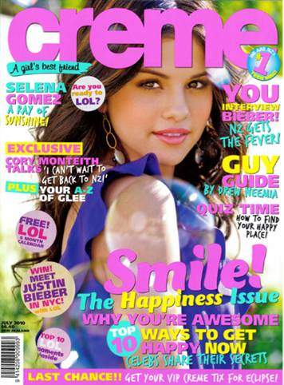
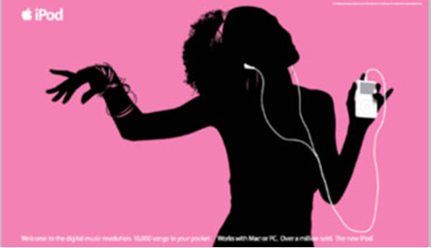
Design Element
White Space .
White space is the absence of text and graphics. It breaks up text and graphics. It provides visual breathing room for the eye. Add white space to make a page less cramped, confusing or overwhelming.
The most obvious benefit of whitespace is that it increases legibility Believe it or not whitespace between paragraphs and around blocks of text actually helps people understand what they are reading better.
The space created is not always ‘white’. This space maybe a colour or texture but either way it is space within a design that does not include screen elements.
Why use it ?
Good use of white space. – Poster Design
Good use of white space. – Magazine
Cluttered Little or no white space.
Without it, your page would look cluttered and messy, readers wouldn’t be able to tell what words relate to the images, and it would be hard to read (so you probably wouldn’t be read).

Slide 17
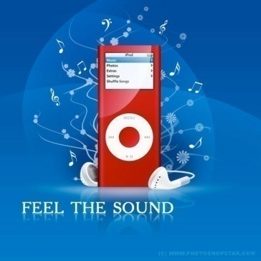
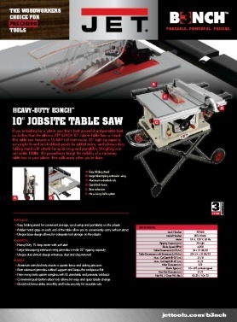
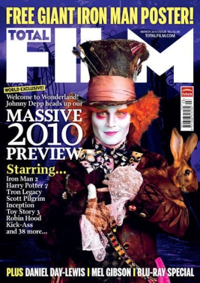
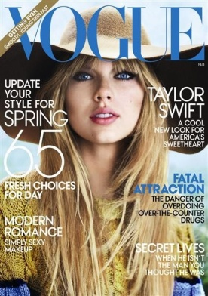
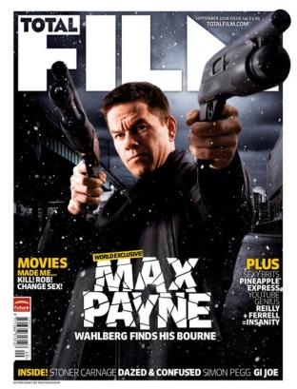
Design Element
Colour .
Although colour can make a layout more dynamic, it is important to consider why you
want to use colour and what you would like the colour to achieve. Think about what
colours are most appropriate to your message and your audience.
To use colour in your piece:
Make important text a different colour than the rest of the copy.
Use a bright colour to tell the reader where to look first.
3. Use bright colours together to help create a feeling of excitement.
4. Repeat a colour from an image and use it with corresponding type or as a
background to help unify the layout.
5. Colour code a document (such as a training manual) with large amounts of text
to help organize the piece.
6. Use an appropriate colour to help differentiate parts of a chart or graph.
7. Use colours such as pastels to create a soothing mood, or more bright colours to
create excitement.

Slide 18
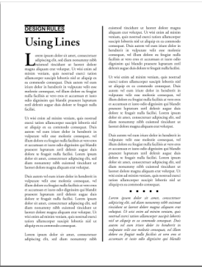
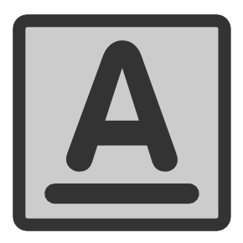
Design Element
Lines
Lines can be used in a variety of ways in a layout:
They help
to organize information; They can direct your readers' eye as to the organization of
the layout;
They can create a mood; And, they can give rhythm and movement.
For example, lines can organize information on your page. A line can define the
boundaries of your page. Vertical or horizontal lines can also be used to direct your
readers from one piece of information to another. To create a mood, use a wavey
line to give the piece a feeling of movement.
Lines in your piece can:
• Convey a mood or an emotion.
• Organize the design.
• Establish columns of text.
• Create a texture.
• Create movement.
• Define shape.
• Call attention to a word.
• Connect pieces of information in your layout.
• Frame an image or a word.
Lines Can Provide Texture
Organize the design.
Establish columns of text.
Define shape

Slide 19




Design Element
Unity
Unity helps organize a visual image, facilitating interpretation and understanding.
Unity can be achieved through the use of similar shapes.
Unity can be achieved through the use of a common pattern.
Can you spot Unity in choice of colour, the use of strong shapes and how the background relates to the text.
Unity can also be used to great effect inside the magazine to link articles and pages together.
Unity can be achieved through the use of a common background.

