Slide 1
Tolerances
It is not possible in practice to manufacture products to the exact figures displayed on an engineering drawing. The accuracy depends largely on the manufacturing process used and the care taken to manufacture a product. A tolerance value shows the manufacturing department the maximum allowable variation from the size.
Each dimension on a drawing must include a tolerance value. This can appear either as:
a general tolerance value applicable to several dimensions. i.e. a note specifying that the General Tolerance +/- 0.5 mm.
or a tolerance specific to that dimension
Note the larger size limit is placed above the lower limit.

Slide 2
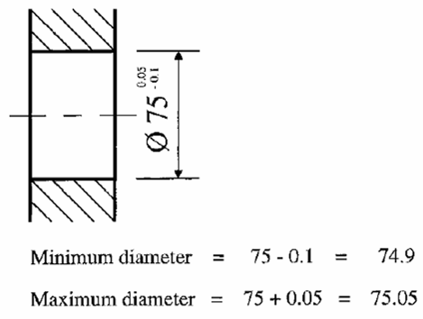
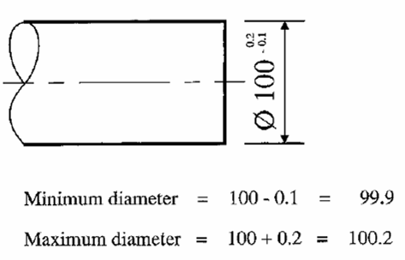
Tolerances
Here are some ways which you will see tolerances shown on drawings, it is the way you should show tolerances if asked to do so.

