Slide 1
The 3 P’s
Introduction
Graphic Communication uses what is collectively known as the 3P’s:
Preliminary
Production
Promotional graphics.
We will look at each one of these in turn

Slide 2
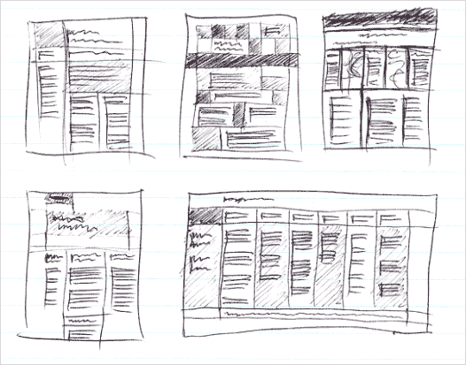
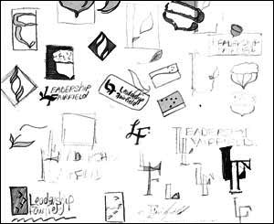
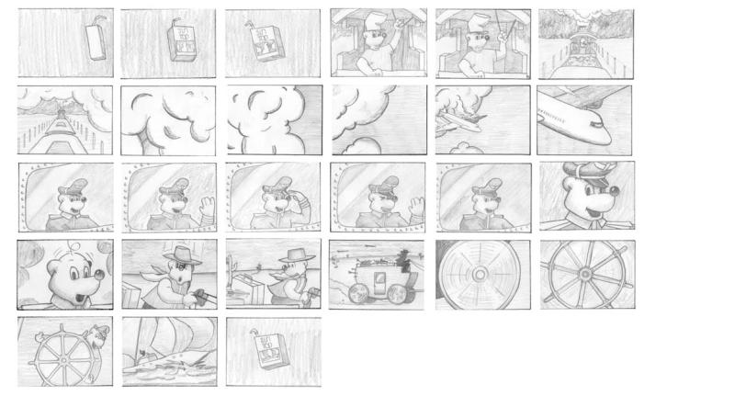
The 3 P’s
Preliminary
Preliminary graphics is concerned with the initial stages of graphic design, all your rough or introductory work. Preliminary graphics often take the form of ‘thumbnail sketches’ which are small rough sketches designed to give a quick representation of your designs.
These sketches are ideal at this stage of the design process as they do not take long and give you an immediate representation of your work. They also allow you to develop a whole range of ideas quickly which allows you to build on and expand your designs.
Thumbnails

Slide 3
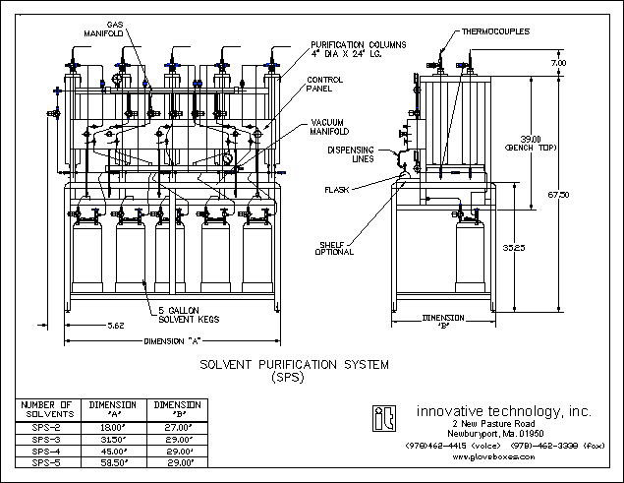
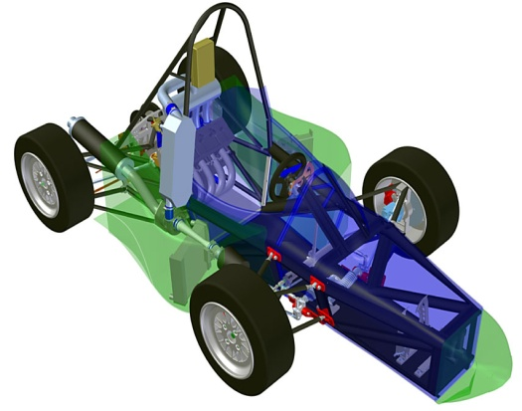
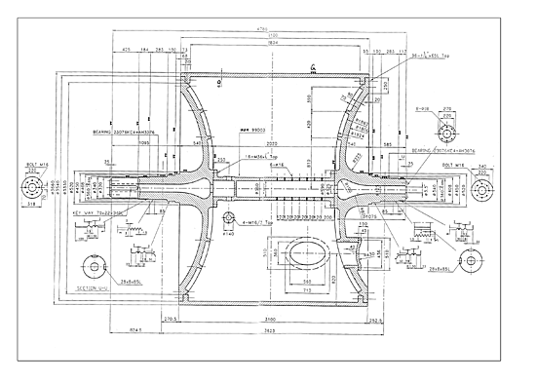
The 3 P’s
Production
For a graphic image to be considered a ‘production’ graphic it must convey certain pieces of information which would be of use to someone like a technologist, engineer, architect etc.
Production Graphics are concerned with telling us as much information as possible about a product. For example, it would be of benefit to know things like dimensions, moving parts, cross sections, weight, material selection etc.
These drawing usually come in the form of Orthographic Drawings, Sectional Views, Exploded Views, Assembly Views, Perspective, Isometric, Sections, Stepped Sections, Cut Aways etc.
In order for the drawings to be clear and concise to the manufacturing sector, the drawings are usually produced on AutoCAD or other CAD packages in the form of working drawings or 3D models.

Slide 4
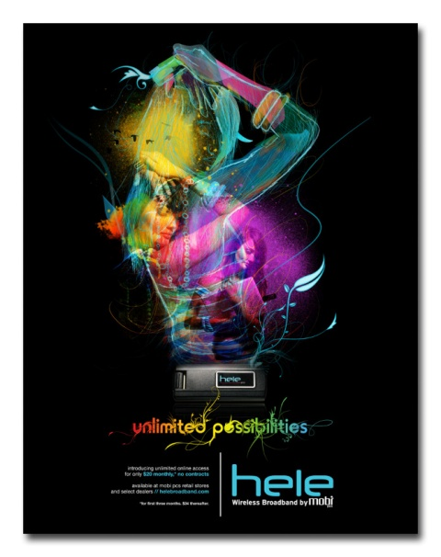
The 3 P’s
Promotional
Promotional Graphics are extensively used by the sales and marketing departments of companies. This is where the product or design is displayed, advertised and put into the market place.
Promotional graphics come in the form of posters, advertisements, leaflets, flyers, displays etc.
In order for a piece of promotional work to be effective, it must attract the consumers attention and make them want to look at it.
Promotional Graphics are strongly linked with the A–Z of Desk Top Publishing, and a good promotional graphic will hit many of the criteria described in the document.
Promotional Graphics are usually created on software packages such as Corel Draw, Adobe Photoshop, Microsoft Publisher etc.

